Slide 1

Angular Change Detection
Understand the inners of Angular 🔋

Slide 2
Topics
🧩 Angular Change Detection
🌲 Angular Component Tree
🔌 Zone.js & NgZone
🛡️ OnPush Change Detection
✨ Signal Components ✨

Slide 3
What is Change Detection anyway?
🤔

Slide 4
Change Detection
@Component({
selector: 'my-app',
template: `
<div>{{ state }}</div>
<button (click)="updateState()">click me</button>
`,
})
export class AppComponent {
state = 'state';
updateState(): void {
this.state = 'updated';
}
}

Slide 5
Change Detection
@Component({
selector: 'my-app',
template: `
<div>{{ state }}</div>
<button (click)="updateState()">click me</button>
`,
})
export class AppComponent {
state = 'state';
updateState(): void {
this.state = 'updated';
}
}

Slide 6
Change Detection
@Component({
selector: 'my-app',
template: `
<div>{{ state }}</div>
<button (click)="updateState()">click me</button>
`,
})
export class AppComponent {
state = 'state';
updateState(): void {
this.state = 'updated';
}
}

Slide 7
🌲 Angular Component Tree
Angular is a component oriented framework

Slide 8
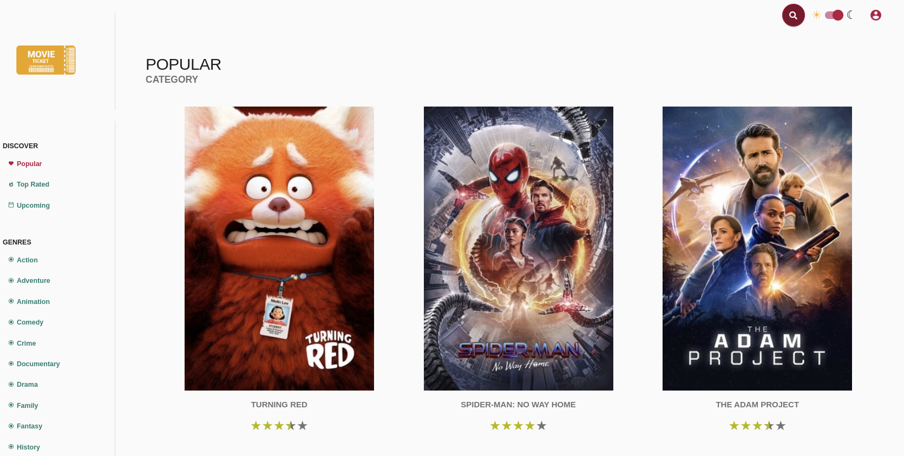
Rendered application in the browser

Slide 9
Component Structure
WidgetBar
AppComponent
Sidebar
NavItem
MovieList
MovieCard
StarRating

Slide 10
Component Tree

Slide 11
Component Tree
AppComponent
Sidebar
MovieList
NavItem
MovieCard
StarRating

Slide 12
Component Tree
💡AppRef
AppComponent
Sidebar
MovieList
NavItem
MovieCard
StarRating

Slide 13
Default Change Detection
Idle (nothing happened)
Change detected (component dirty check)

Slide 14
Component Tree
tick()

Slide 15
Component Tree
tick()

Slide 16
Component Tree
tick()

Slide 17
Component Tree
tick()

Slide 18
Component Tree
tick()

Slide 19
Component Tree
tick()

Slide 20

Demo Time!
DirtyCheckComponent

Slide 21
How is that possible? 🤔

Slide 22
Zone.js & NgZone API patching
ZONE

Slide 23
What is Zone.js / NgZone?
ZONE

Slide 24
Browser
Browser + zone.js
Patched API
Native API
Native API

Slide 25
Which APIs are patched?
target.addEventListener
target.onProp (target.onclick and so on)
setTimeout/setInterval/setImmediate
XMLHttpRequest
Promise.then, PromiseRejectEvent
requestAnimationFrame
alert/prompt/confirm
...
😱 Scarry Full List 😱

Slide 26
API patching
ZONE

Slide 27
Somewhere in zone.js
const originalMethod = EventTarget.prototype.addEventListener;
EventTarget.prototype.addEventListener = (eventName, originalCallback, useCapture) => {
const patchedCallback = (event) => {
doSomeMagic()
const cbResult = originalCallback(event);
console.log(’Patched!’);
return cbResult;
}
return originalMethod.apply(this, [eventName, patchedCallback, useCapture]);
};

Slide 28
Somewhere in zone.js
const originalMethod = EventTarget.prototype.addEventListener;
EventTarget.prototype.addEventListener = (eventName, originalCallback, useCapture) => {
const patchedCallback = (event) => {
doSomeMagic()
const cbResult = originalCallback(event);
console.log(’Patched!’);
return cbResult;
}
return originalMethod.apply(this, [eventName, patchedCallback, useCapture]);
};

Slide 29
Somewhere in zone.js
const originalMethod = EventTarget.prototype.addEventListener;
EventTarget.prototype.addEventListener = (eventName, originalCallback, useCapture) => {
const patchedCallback = (event) => {
doSomeMagic()
const cbResult = originalCallback(event);
console.log(’Patched!’);
return cbResult;
}
return originalMethod.apply(this, [eventName, patchedCallback, useCapture]);
};

Slide 30
Somewhere in zone.js
const originalMethod = EventTarget.prototype.addEventListener;
EventTarget.prototype.addEventListener = (eventName, originalCallback, useCapture) => {
const patchedCallback = (event) => {
doSomeMagic()
const cbResult = originalCallback(event);
console.log(’Patched!’);
return cbResult;
}
return originalMethod.apply(this, [eventName, patchedCallback, useCapture]);
};

Slide 31
ApplicationRef
@Injectable()
export class ApplicationRef {
constructor() {
this._zone.onMicroTaskEmpty.subscribe(() => {
this.tick();
});
}
tick(): void {
for (let view of this._views) {
view.detectChanges();
}
}
}

Slide 32
ApplicationRef
@Injectable()
export class ApplicationRef {
constructor() {
this._zone.onMicroTaskEmpty.subscribe(() => {
this.tick();
});
}
tick(): void {
for (let view of this._views) {
view.detectChanges();
}
}
}
💡

Slide 33
Default Change Detection
Idle (nothing happened)
Marked Dirty (no check done)
Rerendered (component dirty check)

Slide 34

User clicks on a button
CLICK

Slide 35
On any user event, Angular will call markDirtyAndPreventDefault which marks the component + all ancestors as dirty
CLICK
markDirty

Slide 36
On the other hand Zone notifies ApplicationRef that a click happened
TICK
Z
CLICK
markDirty

Slide 37
From the top component down every component is change detected by Angular
TICK
Z
CLICK
markDirty

Slide 38
Bottom Up dirty marking Top Down Rendering
markDirty
Z
tick()

Slide 39
markDirty

Slide 40
Z
tick()

Slide 41



Browser
ZONE
Trigger Render
Framework
Trigger Render
Z
mark dirty
State
mark dirty
render
render
Detect
API call
</>
View
</>

Slide 42
Demo Time!
analyze patched events

Slide 43
Can we do better? 🤔

Slide 44
ChangeDetectionStrategy.OnPush
Component has OnPush strategy

Slide 45
ChangeDetectionStrategy.OnPush
“explicit” change detection
// child.ts
@Input() movie: MovieModel;
// parent.ts
<my-component [movie]="movie" />
💡 equality check (===)
💡 only changes via template

Slide 46
Enable Change Detection OnPush
@Component({
selector: 'app-movie-card,
template: `
Hello World!
`,
changeDetection: ChangeDetectionStrategy.OnPush
})
export class MovieComponent {
// ...
}

Slide 47
ChangeDetectionStrategy.OnPush
OnPush turned on

Slide 48
ChangeDetectionStrategy.OnPush
OnPush turned on
CLICK
markDirty

Slide 49
ChangeDetectionStrategy.OnPush Only dirty path gets change detected
💡
TICK
Z
OnPush turned on
CLICK
markDirty

Slide 50
ChangeDetectionStrategy.OnPush Input binding changed
💡
TICK
Z
💡
Input binding changed
CLICK
markDirty

Slide 51
What does that mean?

Slide 52
CD.Default === Overrender
CLICK

Slide 53
CD.OnPush is a 🛡️
🛡️
CLICK

Slide 54
Demo & Exercise Time!
ChangeDetectionStrategy.OnPush

Slide 55
Manual Change Detection

Slide 56
Change Detection Methods Overview
detectChanges
markForCheck
vs

Slide 57
markForCheck() vs detectChanges()
import { ChangeDetectorRef } from '@angular/core';
export class MovieComponent {
private cdr = inject(ChangeDetectorRef);
handleSthChangedAndMarkAllParentsAsDirty() {
logic();
this.cdr.markForCheck();
}
handleSthChangedAndDetectChangesForThisViewAndItsChildren() {
logic();
this.cdr.detectChanges();
}
}

Slide 58
CD with async pipe

Slide 59
CD with async pipe
{ }
movies$
next

Slide 60
CD with async pipe
Z
{ }
movies$
next
{{ movies$ | async }}
markForCheck

Slide 61
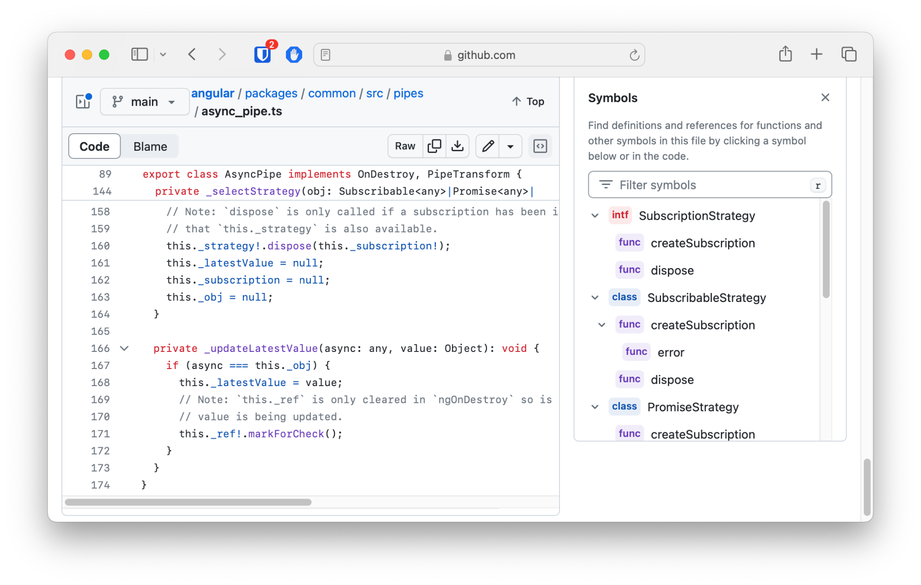
CD with async pipe
Z
{ }
movies$
next
{{ movies$ | async }}
markForCheck

Slide 62
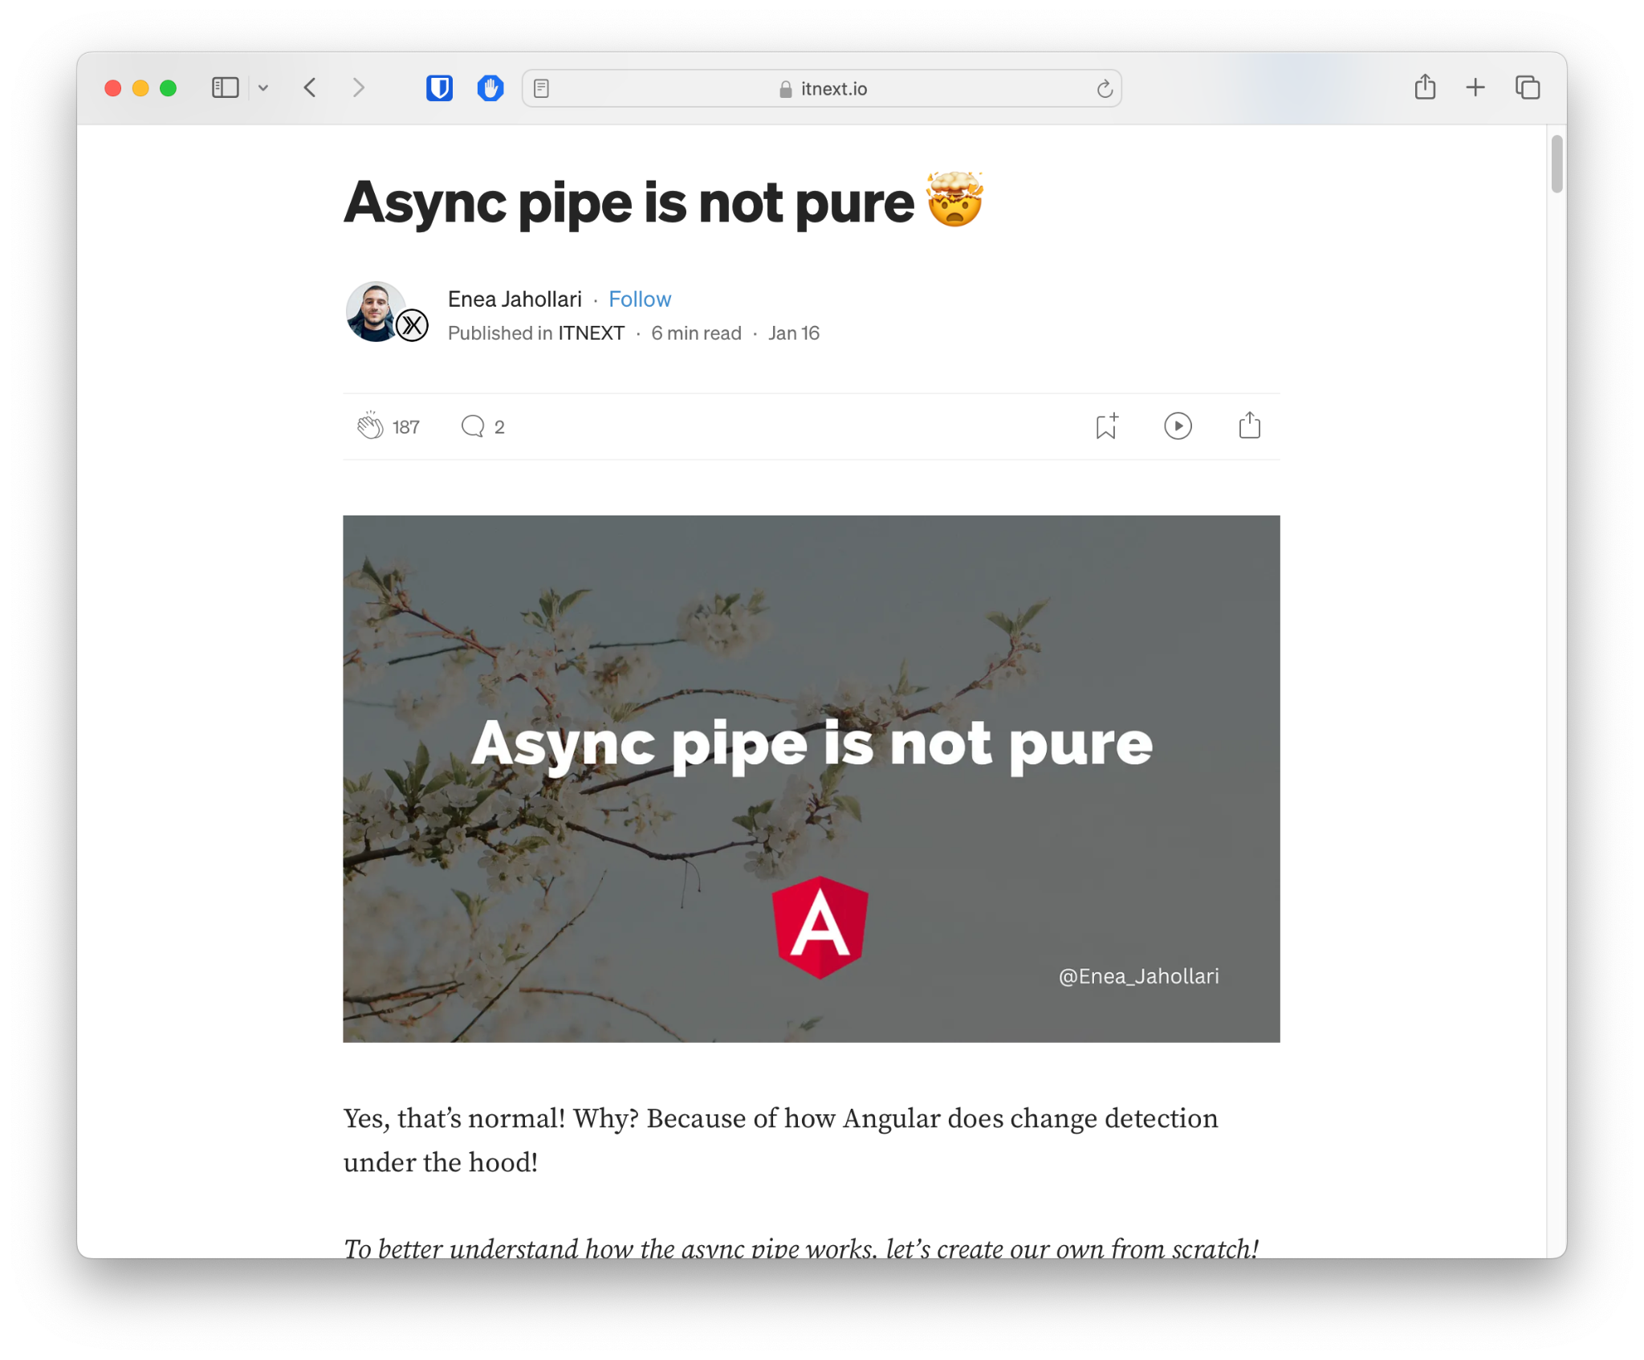
CD with async pipe
Read more here 🔗
TICK
Z
{ }
movies$
next
{{ movies$ | async }}
markForCheck

Slide 63
CD with async pipe
Z
{ }
movies$
next
{{ movies$ | async }}
markForCheck

Slide 64
CD with async pipe
TICK
Z
{ }
movies$
next
{{ movies$ | async }}
markForCheck

Slide 65
Why do we need to mark all parents/ancestors as dirty 🤔?

Slide 66
CD with async pipe
{ }
movies$
next

Slide 67
CD with custom markForCheck
{ }
movies$
next

Slide 68
CD with custom markForCheck
{ }
movies$
next
{{ movies$ | mfc }}
customMarkForCheck()

Slide 69
CD with custom markForCheck
TICK
Z
{ }
movies$
next
{{ movies$ | mfc }}
customMarkForCheck()

Slide 70
CD with custom markForCheck
TICK
Z
{ }
movies$
next
{{ movies$ | mfc }}
customMarkForCheck()

Slide 71
CD with custom markForCheck
TICK
Z
{ }
movies$
next
{{ movies$ | mfc }}
OnPush + Not dirty === No re-render
customMarkForCheck()

Slide 72
CD with custom markForCheck
Not re-rendered
TICK
Z
{ }
movies$
next
{{ movies$ | mfc }}
OnPush + Not dirty === No re-render
customMarkForCheck()

Slide 73
CD with custom markForCheck
Not re-rendered
TICK
Z
{ }
movies$
BROKEN STATE
next
{{ movies$ | mfc }}
OnPush + Not dirty === No re-render
customMarkForCheck()

Slide 74
Demo Time!
Manual CD vs async pipe

Slide 75
Can we do better 🤔?

Slide 76
CD with Signals🚦
Idle (nothing happened)
Marked as RefreshView (no check done)
Marked as HAS_CHILD_VIEWS_TO_REFRESH
Rerendered

Slide 77
Effects re-run every time a signal inside them changes
const movie = signal<Movie | null>(null);
effect(() => {
console.log('movie', this.movie());
});
movie.set({ title: 'Interstellar' });
setTimeout(() => movie.set({ title: 'Inception' }), 1000);

Slide 78
Effects re-run every time a signal inside them changes
const movie = signal<Movie | null>(null);
effect(() => {
console.log('movie', this.movie());
});
movie.set({ title: 'Interstellar' });
setTimeout(() => movie.set({ title: 'Inception' }), 1000);
👉

Slide 79
Effects re-run every time a signal inside them changes
const movie = signal<Movie | null>(null);
effect(() => {
console.log('movie', this.movie());
});
movie.set({ title: 'Interstellar' });
setTimeout(() => movie.set({ title: 'Inception' }), 1000);
// movie { title: ‘Interstellar’ }
👉

Slide 80
Effects re-run every time a signal inside them changes
const movie = signal<Movie | null>(null);
effect(() => {
console.log('movie', this.movie());
});
movie.set({ title: 'Interstellar' });
setTimeout(() => movie.set({ title: 'Inception' }), 1000);
// movie { title: ‘Interstellar’ }
// movie { title: ‘Inception’ }
👉

Slide 81
CD with async pipe
{ }
movies$
next

Slide 82
CD with async pipe
CD with Signals

Slide 83
CD with async pipe
CD with Signals

Slide 84
CD with signals
{ }
movies()
set/update

Slide 85
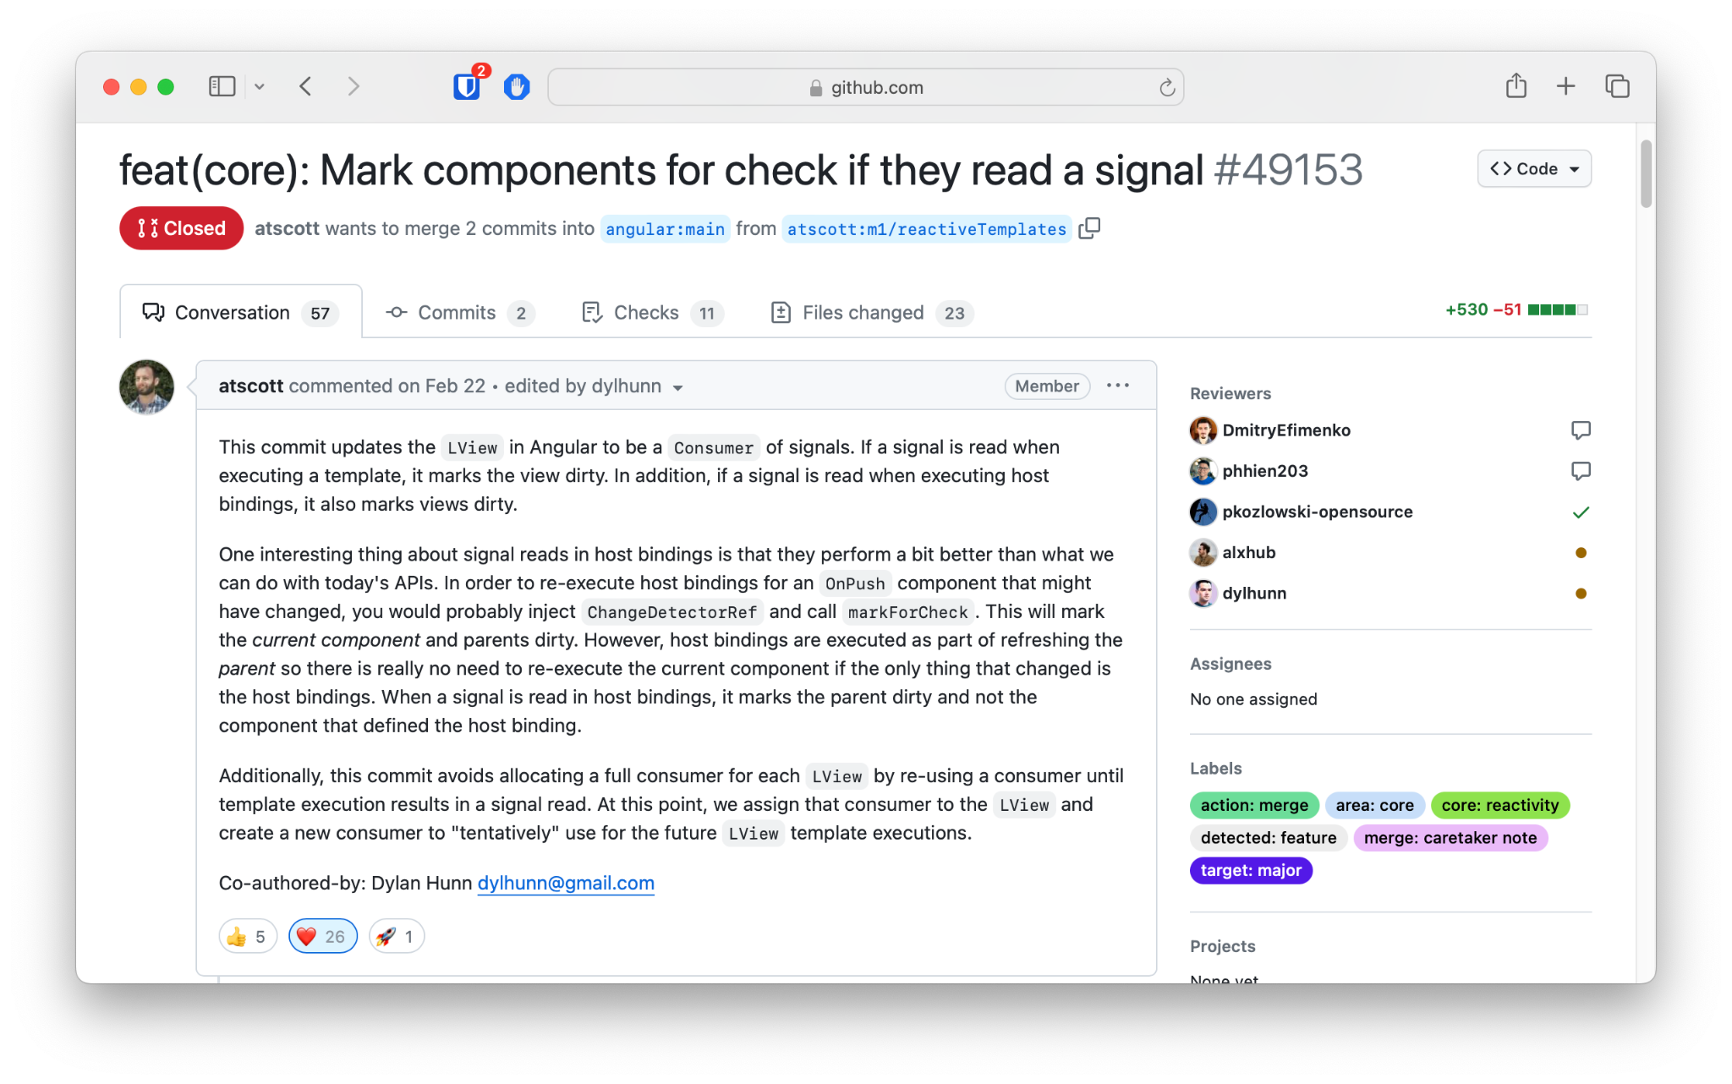
Components are marked dirty (for check) if read a signal⚡️
Read more here: https://github.com/angular/angular/pull/49153

Slide 86
CD with signals
{ }
movies()
set/update

Slide 87
CD with signals
{ }
movies()
set/update
template effect runs

Slide 88
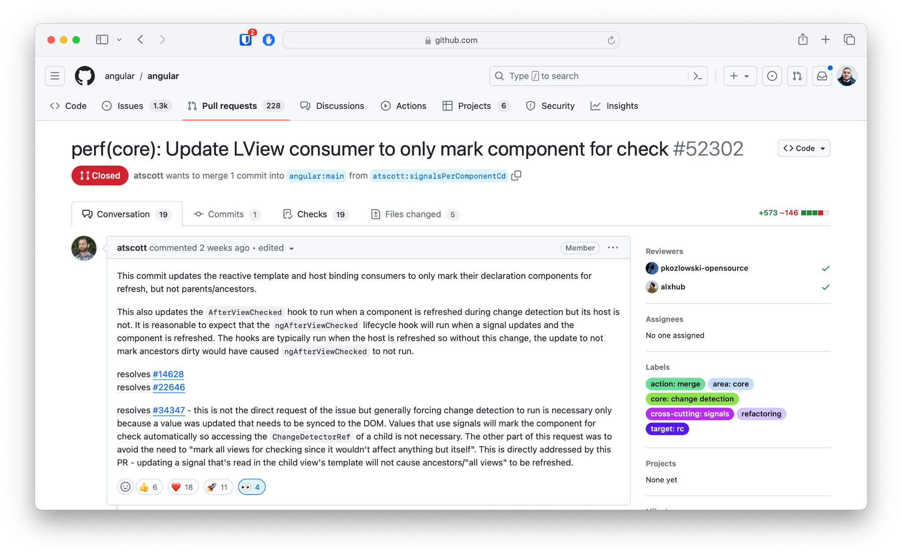
Local change detection with Signals + OnPush ⚡️
https://github.com/angular/angular/pull/52302

Slide 89
CD with signals
Marked as RefreshView (no check done)
{ }
movies()
set/update
template effect runs
markViewDirtyFromSignal

Slide 90
CD with signals
Marked as RefreshView (no check done)
{ }
movies()
set/update
template effect runs
markViewDirtyFromSignal

Slide 91
CD with signals
Marked as HAS_CHILD_VIEWS_TO_REFRESH
Marked as RefreshView (no check done)
{ }
movies()
set/update
template effect runs
markViewDirtyFromSignal

Slide 92
CD with signals
Marked as HAS_CHILD_VIEWS_TO_REFRESH
Marked as RefreshView (no check done)
{ }
movies()
set/update
template effect runs
markViewDirtyFromSignal

Slide 93
CD with signals
Marked as HAS_CHILD_VIEWS_TO_REFRESH
Marked as RefreshView (no check done)
Z
{ }
movies()
set/update
template effect runs
markViewDirtyFromSignal

Slide 94
CD with signals
Marked as HAS_CHILD_VIEWS_TO_REFRESH
Marked as RefreshView (no check done)
TICK
Z
{ }
movies()
set/update
template effect runs
markViewDirtyFromSignal

Slide 95
CD with signals
Marked as HAS_CHILD_VIEWS_TO_REFRESH
Marked as RefreshView (no check done)
TICK
Z
{ }
movies()
set/update
template effect runs
markViewDirtyFromSignal

Slide 96
New Top Down Change Detection TargetedMode ⚡️

Slide 97
New Top Down Change Detection (TargetedMode)
NgZone triggers change detection in GlobalMode
In GlobalMode we check CheckAlways and Dirty OnPush components

Slide 98
New Top Down Change Detection (TargetedMode)
NgZone triggers change detection in GlobalMode
In GlobalMode we check CheckAlways and Dirty OnPush components
What triggers TargetedMode?
When in GlobalMode we encounter a Non-Dirty OnPush component, we switch to TargetedMode

Slide 99
New Top Down Change Detection (TargetedMode)
NgZone triggers change detection in GlobalMode
In GlobalMode we check CheckAlways and Dirty OnPush components
What triggers TargetedMode?
When in GlobalMode we encounter a Non-Dirty OnPush component, we switch to TargetedMode
In TargetedMode:
Only refresh a view if it has the RefreshView flag set
DO NOT Refresh CheckAlways or regular Dirty flag views
If we reach a view with RefreshView flag, traverse children in GlobalMode
We do this because there may be CheckAlways children underneath the view that need to be refreshed.

Slide 100
CD with signals
Marked as HAS_CHILD_VIEWS_TO_REFRESH
Marked as RefreshView (no check done)
Global
TICK
CheckAlways
Z
{ }
movies()
set/update
template effect runs
markViewDirtyFromSignal

Slide 101
CD with signals
Marked as HAS_CHILD_VIEWS_TO_REFRESH
Marked as RefreshView (no check done)
Global
TICK
CheckAlways
Z
{ }
movies()
set/update
template effect runs
markViewDirtyFromSignal

Slide 102
CD with signals
Marked as HAS_CHILD_VIEWS_TO_REFRESH
Marked as RefreshView (no check done)
Global
TICK
OnPush (Not dirty)
Z
{ }
movies()
set/update
template effect runs
markViewDirtyFromSignal

Slide 103
CD with signals
Marked as HAS_CHILD_VIEWS_TO_REFRESH
Marked as RefreshView (no check done)
Global
TICK
OnPush (Not dirty)
Z
{ }
movies()
Convert to TargetedMode
set/update
template effect runs
markViewDirtyFromSignal

Slide 104
CD with signals
Marked as HAS_CHILD_VIEWS_TO_REFRESH
Marked as RefreshView (no check done)
Targeted
TICK
CheckAlways
Z
{ }
movies()
set/update
template effect runs
markViewDirtyFromSignal

Slide 105
CD with signals
Marked as HAS_CHILD_VIEWS_TO_REFRESH
Marked as RefreshView (no check done)
Targeted
TICK
OnPush (Not dirty)
Z
{ }
movies()
set/update
template effect runs
markViewDirtyFromSignal

Slide 106
CD with signals
Marked as HAS_CHILD_VIEWS_TO_REFRESH
Marked as RefreshView (no check done)
Targeted
TICK
RefreshView
Z
{ }
movies()
set/update
template effect runs
markViewDirtyFromSignal

Slide 107
CD with signals
Marked as HAS_CHILD_VIEWS_TO_REFRESH
Marked as RefreshView (no check done)
Targeted
TICK
RefreshView
Z
{ }
movies()
set/update
template effect runs
markViewDirtyFromSignal

Slide 108
CD with signals
Marked as HAS_CHILD_VIEWS_TO_REFRESH
Marked as RefreshView (no check done)
Targeted
TICK
RefreshView
Z
{ }
movies()
Convert to GlobalMode
set/update
template effect runs
markViewDirtyFromSignal

Slide 109
CD with signals
Marked as HAS_CHILD_VIEWS_TO_REFRESH
Marked as RefreshView (no check done)
Global
TICK
CheckAlways
Z
{ }
movies()
set/update
template effect runs
markViewDirtyFromSignal

Slide 110
CD with signals
Marked as HAS_CHILD_VIEWS_TO_REFRESH
Marked as RefreshView (no check done)
Global
TICK
CheckAlways
Z
{ }
movies()
set/update
template effect runs
markViewDirtyFromSignal

Slide 111
Way better 🚀!!!

Slide 112
One more thing!

Slide 113
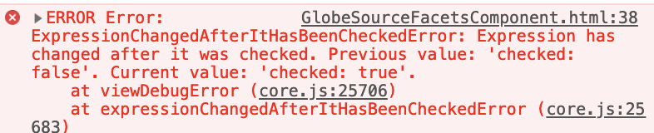
This error is gone when using signals! 🎉

Slide 114
Demo & Exercise Time!
ChangeDetection - signals
https://jeanmeche.github.io/angular-change-detection/

Slide 115
Can we do better 🤔?

Slide 116
Let’s go zoneless!
TICK
⚔️
Z
{ }
movies$
next
{{ movies$ | async }}
markForCheck

Slide 117
Let’s go zoneless!
TICK
⁉️
{ }
movies$
🤔 But who triggers the tick now?
next
{{ movies$ | async }}
markForCheck

Slide 118
Let’s go zoneless!
🔥🔥🔥🔥
ChangeDetectionScheduler
notify()
TICK
{ }
movies$
next
{{ movies$ | async }}
markForCheck

Slide 119
Zoneless: provideZonelessChangeDetection
import {ApplicationConfig, ɵprovideZonelessChangeDetection} from '@angular/core';
export const appConfig: ApplicationConfig = {
providers: [
ɵprovideZonelessChangeDetection()
]
};
👈️ this provides two things:
NoopZone (no-op)
default ChangeDetectionScheduler

Slide 120
Zoneless: provide custom ChangeDetectionScheduler
import {ɵChangeDetectionScheduler} from '@angular/core';
export const appConfig = {
providers: [
{
provide: ɵChangeDetectionScheduler,
useClass: CustomCDScheduler,
}
]
};
import {
ApplicationRef,
ɵChangeDetectionScheduler as ChangeDetectionScheduler
} from '@angular/core';
export class CustomCDScheduler implements ChangeDetectionScheduler {
private notify$ = new Subject<void>();
#appRef = inject(ApplicationRef);
notify(): void {
schedule(() => this.#appRef.tick());
}
}
💡 use any scheduling technique:
setTimeout rAF MessageQueue Promise

Slide 121
Zoneless: Remove the polyfill
{
"build": {
"builder": "@angular-devkit/build-angular:application",
"options": {
"polyfills": [
"zone.js"
]
}
}
}
⚔️
You can remove this polyfill

Slide 122
Zoneless: Remove the polyfill
$ npm uninstall zone.js
// package.json
{
"dependencies": {
"zone.js": "~0.14.3"
}
}
⚔️
You can remove the dependency as well and save bundle size

Slide 123
Demo & Exercise Time!
ChangeDetection - zoneless

Slide 124
Fine grained view-level CD 🔍

Slide 125
CD with async pipe
TICK
Z
{ }
movies$
next
{{ movies$ | async }}
markForCheck

Slide 126
| async pipe
| push pipe
vs
{ }
{ }

Slide 127
| push pipe
signal() value
vs
{ }
{ }

Slide 128
signal() value
*rxLet directive
vs
{ }
{ }

Slide 129
trackBy
💡

Slide 130
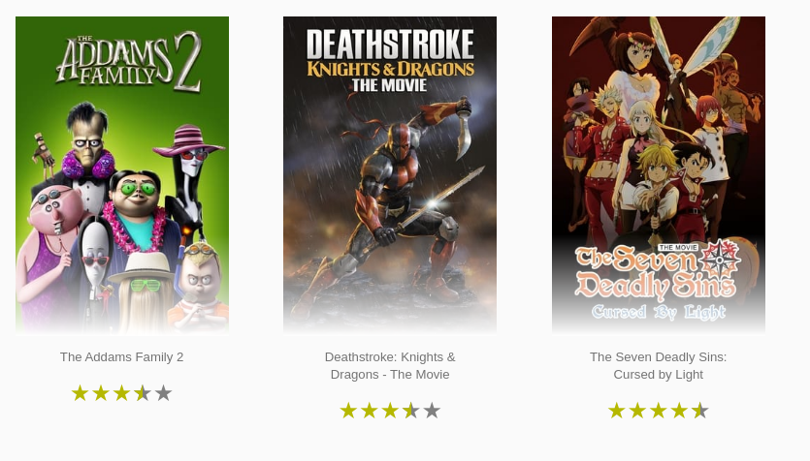
trackBy
<movie-card
*ngFor="let movie of movies;"
[movie]="movie" />
@for (movie of movies) {
<movie-card [movie]="movie" />
}

Slide 131
trackBy
<movie-card
*ngFor="let movie of movies; trackBy: trackByMovie"
[movie]="movie" />
@for (movie of movies; track movie.id) {
<movie-card [movie]="movie" />
}
@for (movie of movies; track 'id') {
<movie-card [movie]="movie" />
}
Help the framework identify nodes it can recycle 🔥

Slide 132
Demo & Exercise Time!
trackBy

